Slide 1
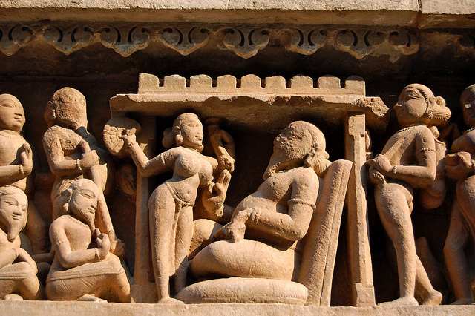

The Psychology of Human Sexuality
[Professor Name]
[Class Section Number]
Notes:
Classroom Recommendations: This PowerPoint is designed to present this information over the course of one (75-minute) class. This information could be expanded to cover two days, if you add some activities from the Noba Instructor Manual or if you extend the amount of time in the current activities.
Overview: This is one of two modules on Human Sexuality. This module provides an overview of the psychological aspects of human sexuality. It provides a brief history of scientific attention to sex, explains the distinction between sex/gender/sexual orientation, includes comparisons of attitudes and behaviors across cultures, and defines sexual consent.
Technical Note: These slides may contain simple click animation so that you can focus students’ attention on a particular question, a selection of text, or an image and not have them be distracted by reading ahead. You can either preview the sequence of animation by going through the slides in slideshow view, visiting the animations tab, or reviewing the slide notes. In the notes you will see a cue - (Click) – that corresponds to each animation.
You may also find hyperlinks to outside videos at various places in the slides. These hyperlinks are embedded in text and indicated by color and in the notes section.

Slide 2
Warm-Up Activity
How did you learn about . . . ?
What was the quality of the information?
Reproduction (fertility, pregnancy, childbirth)
Sexually transmitted infections (eg. HPV, HIV, etc)
Which sexual behaviors are normal (How commonly or frequently people engage in various behaviors)
Which sexual behaviors are appropriate (Which behaviors are legally or morally acceptable)
Sexual Consent
Notes:
The purpose of this slide is to introduce a Warm-up activity.
Materials: Paper and pen
Time: 5 minutes at the beginning of class.
(Click): How did you learn about. . . ? What was the quality of the information?
(Click):
Human reproduction (fertility, pregnancy, childbirth)
Sexually transmitted infections (eg. HPV, HIV, etc)
Which sexual behaviors are normal (How commonly or frequently do people engage in various behaviors)
Which sexual behaviors are appropriate (Which behaviors are legally or morally acceptable)
Sexual Consent
Directions: Have students consider how they learned about various aspects of sex, including sexual anatomy, reproduction, sexual behavior, STIs, and consent. Inform them of the possible sources of information (listed at the bottom of the notes here), and encourage them to consider others not listed. For each source of information, students should consider the quality of the information they received. To help them consider the quality, prompt them to consider whether they believe the information was accurate, whether they have come across contradictory information, whether the information has changed, or whether they have changed their own minds about the initial information. The point of this activity is not to endorse or deny the quality associated with any single channel of information but—rather—to prompt students to realize that they have learned many lessons about sexuality from many sources and that these sources vary in quality.
Discussion Questions: Cautioning students that they do not have to share any specifics from their reflection, encourage them to offer insights gained from this reflection. During the large class discussion try to highlight the two take-home messages: First, students have learned many lessons about sexuality from many sources and that these sources vary in quality. Second, introduce the idea that this lecture will focus on a single channel of information—science. Science is not intended to prescribe morality or political aspects of sexuality. Instead, it is a way of understanding sexuality that can be objective and generalized.
Possible Sources of Information: Parents, Siblings, School Class, Friends, Internet Search, Religious Group, Religious Text, Personal Experience, Educational Program outside of normal schooling, Pornography, Magazine/Newspaper Articles, Research Reports.

Slide 3
Overview
Understanding Sex:
Historical and cultural understanding
Science and sexuality
Sex, Gender, and Sexual Orientation
What is normal?
Biology
Comparisons across cultures
Comparisons within cultures
Consent
Notes:
The purpose of this slide is to provide students with an overview of the material that will be covered during the lecture.
Technical Note: These slides may contain simple click animation so that you can focus students’ attention on a particular question, a selection of text, or an image and not have them be distracted by reading ahead. You can either preview the sequence of animation by going through the slides in slideshow view, visiting the animations tab, or reviewing the slide notes. In the notes you will see a cue - (Click) – that corresponds to each animation.
You will also find hyperlinks to outside videos at various places in the slides. These hyperlinks are embedded in text and indicated by color and in the notes section.

Slide 4
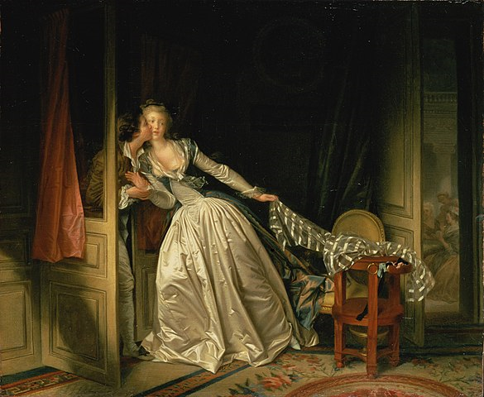
Sex Across History and Culture
Notes:
The purpose of this slide is to discuss Sex as a topic across History and Culture.
This is an opportunity to point out that sex is a topic that has been discussed (or NOT discussed) throughout history and across cultures. This is an opportunity to acknowledge that the topic has been of concern throughout human history.

Slide 5
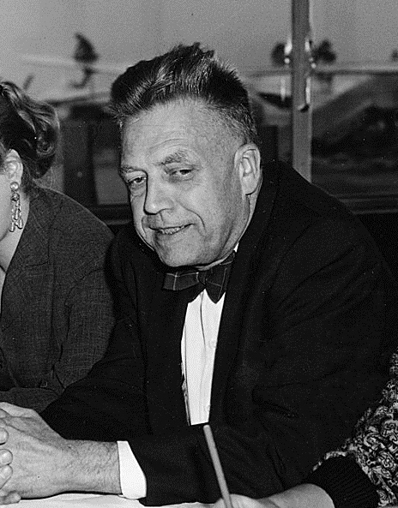
Kinsey and Research on Sex
Alfred Kinsey
Studied the prevalence of sexual fantasies and behaviors
Notes:
The purpose of this slide is to introduce Alfred Kinsey.
Here, you can reinforce the notion that science aims to be objective and to remain aloof of political and moral reasoning about sexuality. It is descriptive rather than prescriptive. Using large and representative samples, researchers are able to generalize results and understand the prevalence of various sexual fantasies and behaviors.

Slide 6
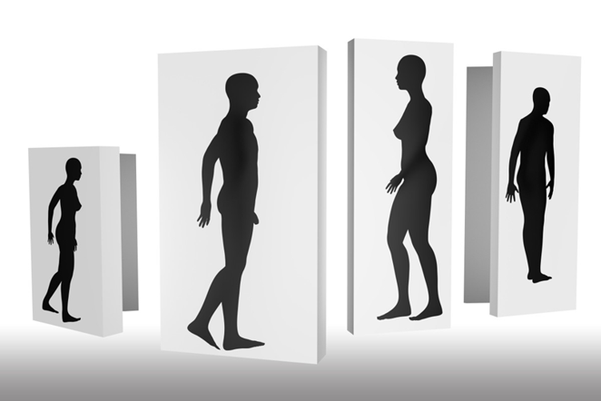
Activity: How would you
research. . . ?
Which factors influence people’s decision to “lose their virginity”
How frequently people of different ages have sex
How common it is for people to have sexual fantasies about someone other than their primary partner
Notes:
The purpose of this slide is to introduce the How would you research. . . ? activity.
Materials: Paper and pen
Time: 10 minutes.
Directions: Have students form small groups. Prompt them to choose one from among the three potential prompts shown on the slide. How would you research this phenomenon? The goal of this activity is to 1) get students to think about human sexuality from a scientific perspective and, 2) increase student appreciation of the difficulties of studying this topic because of the taboos associated with it. You can emphasize to them some important factors to consider:
Developing a hypothesis
Sampling
What types of measures might you use (biological, interview/survey, anonymous, etc)
How will you obtain honest responses?
Ethics
Discussion Questions: Here is a list of possible debriefing questions for this activity. You can shorten the amount of in-class time spent on this activity by assigning a one-page reflection paper as homework.
What emerged from your group discussion that was surprising to you?
What did you learn about the difficulties of studying sex (as opposed to studying other topics in psychology)?
How important do you think it is that human sexuality is a topic that receives scientific/research attention? Why?

Slide 7
Overview
Understanding Sex:
Historical and cultural understanding
Science and sexuality
Sex, Gender, and Sexual Orientation
What is normal?
Biology
Comparisons across cultures
Comparisons within cultures
Consent
Notes:
The purpose of this slide is to provide students with an overview of the material that will be covered during the lecture.
Technical Note: These slides may contain simple click animation so that you can focus students’ attention on a particular question, a selection of text, or an image and not have them be distracted by reading ahead. You can either preview the sequence of animation by going through the slides in slideshow view, visiting the animations tab, or reviewing the slide notes. In the notes you will see a cue - (Click) – that corresponds to each animation.
You will also find hyperlinks to outside videos at various places in the slides. These hyperlinks are embedded in text and indicated by color and in the notes section.

Slide 8

Sex, Gender, and Sexual Orientation
Sex
Gender
Sexual Orientation
Notes:
The purpose of this slide is to define a few key terms regarding human sexuality.
Here, you define 3 key terms:
Sex = biological sex. The sexual and reproductive organs that a person is born with.
Gender = the psychological representation of biological sex. Traditionally, this means an understanding of the behaviors associated with masculinity and femininity. You can ask students to provide stereotypical examples of these such as: Emotions (eg. boys don’t cry), Physical Appearance (egs. girls wear skirts, girls have long hair), or Work (women can cook, men make better combat soldiers). It is important to point out that a person can identify to a greater or lesser degree with masculinity or femininity. Gender can also be fluid and oscillate between the masculine and the feminine.
Sexual Orientation = this refers to the object of a person’s sexual attraction. It is widely agreed that sexual orientation exists on a continuum from same sex attraction (homosexuality) to both sex attraction (bi-sexuality) to opposite sex attraction (heterosexuality).

Slide 9
Overview
Understanding Sex:
Historical and cultural understanding
Science and sexuality
Sex, Gender, and Sexual Orientation
What is normal?
Biology
Comparisons across cultures
Comparisons within cultures
Consent
Notes:
The purpose of this slide is to provide students with an overview of the material that will be covered during the lecture.
Technical Note: These slides may contain simple click animation so that you can focus students’ attention on a particular question, a selection of text, or an image and not have them be distracted by reading ahead. You can either preview the sequence of animation by going through the slides in slideshow view, visiting the animations tab, or reviewing the slide notes. In the notes you will see a cue - (Click) – that corresponds to each animation.
You will also find hyperlinks to outside videos at various places in the slides. These hyperlinks are embedded in text and indicated by color and in the notes section.

Slide 10
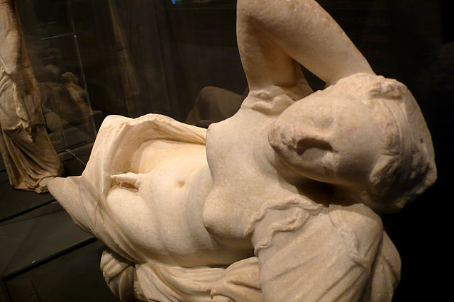
What is Normal?: Biology
Notes:
This slide depicts a photo of a statue of Hermaphroditus. This figure from Greek mythology. In the myth a handsome boy and a female water nymph fell in love. The gods merged their two forms so that they could be united. Hermaphroditus became a symbol of blended sex. People used to refer to “intersex” as “hermaphroditism” and people who were intersex were referred to as “hermaphrodites.” The purpose of this slide is to reinforce or extend the section of the module text dealing with biological variation in sexual production. Here is the central paragraph:
The international scientific and medical communities (e.g., World Health Organization, World Medical Association, World Psychiatric Association, Association for Psychological Science) view variations of sex, gender, and sexual orientation as normal. Furthermore, variations of sex, gender, and sexual orientation occur naturally throughout the animal kingdom. More than 500 animal species have homosexual or bisexual orientations (Lehrer, 2006). More than 65,000 animal species are intersex—born with either an absence or some combination of male and female reproductive organs, sex hormones, or sex chromosomes (Jarne & Auld, 2006). In humans, intersex individuals make up about two percent—more than 150 million people—of the world’s population (Blackless et al., 2000). There are dozens of intersex conditions, such as Androgen Insensitivity Syndrome and Turner’s Syndrome (Lee et al., 2006). The term “syndrome” can be misleading; although intersex individuals may have physical limitations (e.g., about a third of Turner’s individuals have heart defects; Matura et al., 2007), they otherwise lead relatively normal intellectual, personal, and social lives. In any case, intersex individuals demonstrate the diverse variations of biological sex.
Possible discussion questions for the class to consider include:
-- Many species, including humans, have instances in which members of that species are intersex. How does the prevalence of intersex examples affect your thinking about what is sexually normal?
-- Some examples of sexual variation in humans are related to syndromes, which are abnormalities. Although these are associated with certain limitations, such as heart defects, people with these syndromes can also live rich and fulfilling lives. What challenges do these people present to how you think about what is sexually normal?

Slide 11
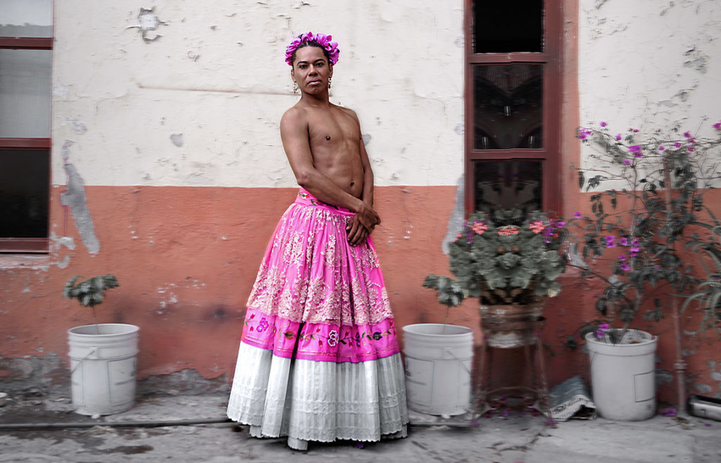
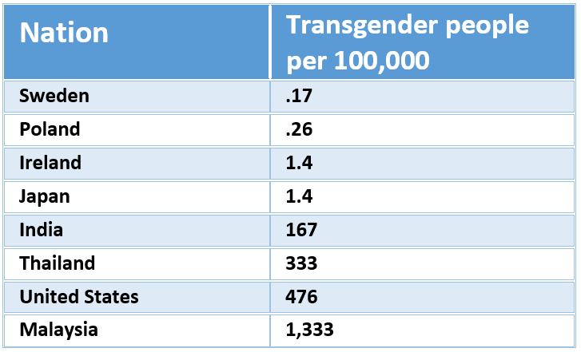
What is Normal?:
Across Cultures
Notes:
The purpose of this slide is to discuss what is considered normal in expression of sexuality across cultures.
(Click): This slide shows a table showing the prevalence rates of transgender people in 8 nations (also presented in the module). This table reveals to important ideas: first, that there are transgender people in all cultures and, second, that there are enormous cultural differences in prevalence. Interestingly, it is not the most democratic, affluent, or Western nations with high percentages of transgender people. Note that India, Thailand, and Malaysia have traditional cultures but relatively high numbers of transgender people. There is also a photo of a “Muxe” (pronounced “Moo-Shay”). The Muxe of Mexico are biological males who dress and act in typically feminine manner.
(Click): Activity:
Have your students guess which country out of the following has the highest prevalence rates of transgender individuals:
Nation: Transgender people per 100,000
Sweden: .17
Poland .26
Ireland 1.4
Japan 1.4
India 167
Thailand 333
United States 476
Malaysia 1.333
Optional follow up question: Has anyone ever visited a nation which has a higher occurrence of transgender people than your own?

Slide 12
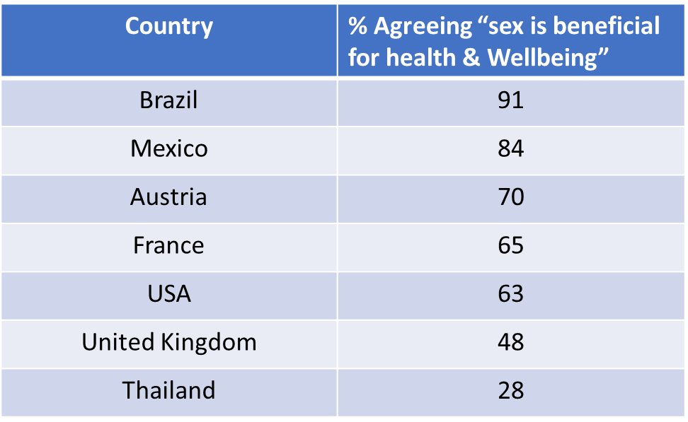
What is Normal?:
Across Cultures
Notes:
This slide shows the % of respondents who agree that “sex is beneficial for health and well-being.” If you use clickers or similar technology you might consider having your class vote on this same statement. As the table reveals, sex is widely regarded as beneficial but there is also large cultural variation.

Slide 13
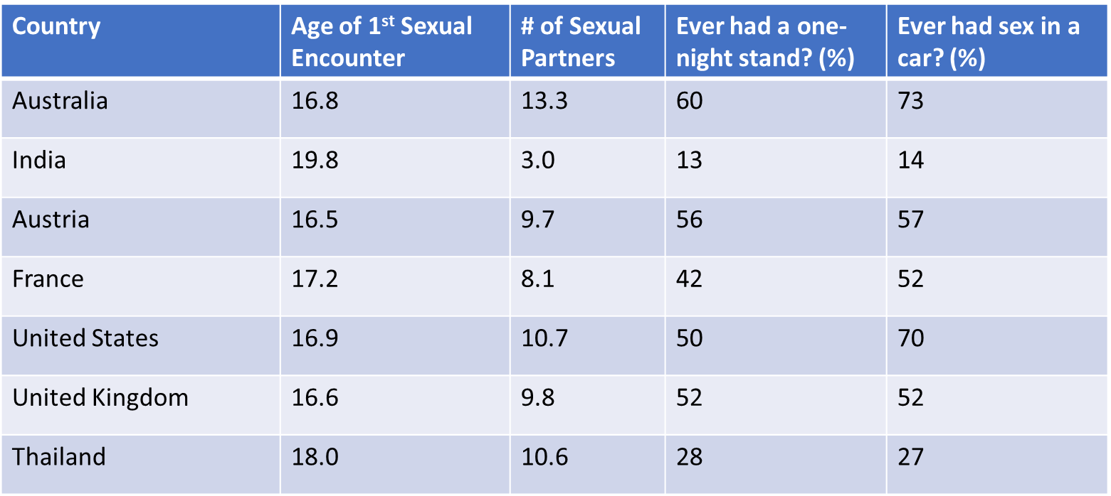
What is Normal?:
Across Cultures
Notes:
The purpose of this slide is to continue the discussion on what is considered normal in expression of sexuality across cultures.
From Durex (2005) survey with 317,000 respondents from 41 nations, http://www.data360.org/pdf/20070416064139.Global%20Sex%20Survey.pdf
This slide extends the data presented in the module by revealing results from the 2005 Durex Global Survey. Although that survey includes 41 nations, we have elected to present only 7 here (representing geographic and cultural diversity, but also giving preference to English speaking nations that constitute the largest portion of Noba users). Please check the survey to add any additional countries to this table. The table shows age of first sexual encounter (coital sex), the lifetime number of sexual partners (at the time of the survey), the percent of respondents who endorsed having a one-night stand, and those who reported having had sex in a car. You may elect to facilitate a class discussion in which you ask students for their responses to this data, or you might consider allowing them to discuss this in smaller groups.

Slide 14

What is Normal?:
Within Cultures
Discussion
Attitudes toward sex outside of marriage
Attitudes toward sex between members of different religions
Attitudes toward same sex relationships
Attitudes toward teenagers having sex
Notes:
The purpose of this slide is to discuss considered normal in expression of sexuality within cultures.
Materials: None, but one student might act as note-taker and “reporter” if a debriefing is conducted with the whole class.
Time: 5 minutes.
Directions: Have students form small groups. Prompt them to choose one from among the four potential prompts shown on the slide. Instruct them to discuss attitudes regarding this prompt. Specifically, direct them to consider the following:
--How much agreement/disagreement currently exists on the topic?
--How have cultural norms changed, if at all, over time regarding this topic?
--What were the factors that originally informed norms and attitudes on this topic? How have those changed?
--What does this discussion reveal about what is considered “normal” sex?
The goal of this activity is to 1) get students to think about where norms come from and how they change over time, and, 2) to understand within-culture variation in norms.

Slide 15
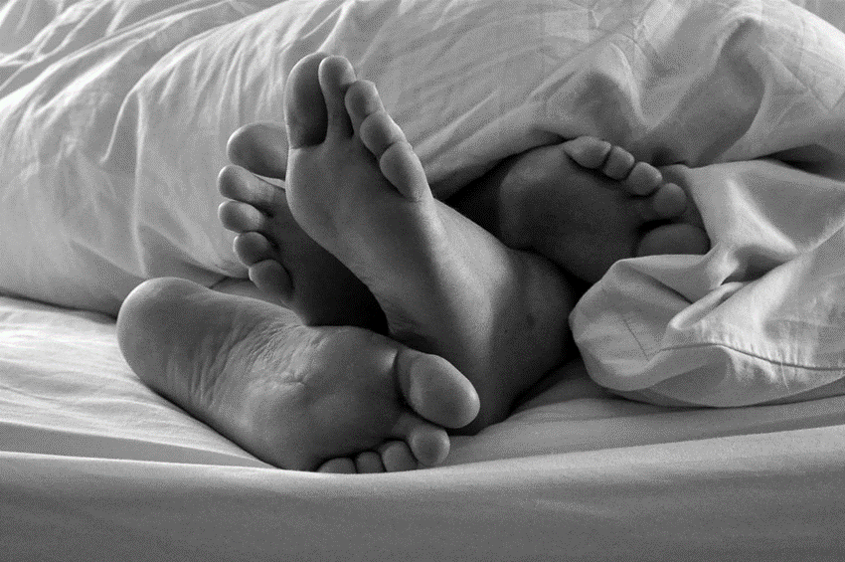
What Are People Doing?
Masturbation
Sex (coital, oral, anal)
Sexual Fantasy
Paraphilic Disorders
Notes:
This is an opportunity to ensure that students are clear on definitions and key concepts. There are two slides associated with this topic. The first is a slide that simply lists the major behaviors. These include:
Masturbation (self-pleasuring)
Sex (with partner; here we cluster coital, oral and anal together)
Sexual fantasy
Paraphilias (behaviors seen as disordered, primarily because they have a victim). You can clearly define each and ask students if they are clear on these concepts.

Slide 16
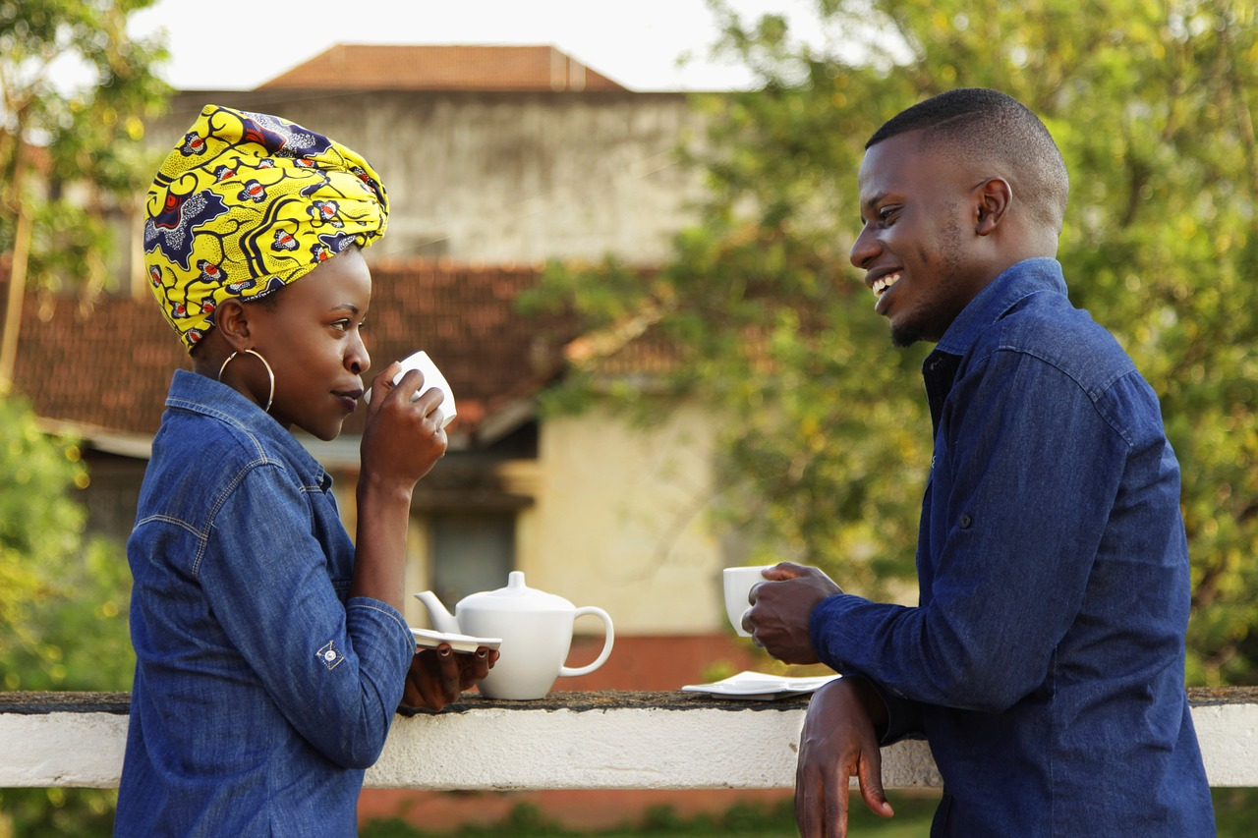
What Are People Doing?
Sexual Fantasy
Activity: Categories of Sexual Fantasies
Notes:
The purpose of this slide is to facilitate an activity in which students form small groups and discuss the topic of sexual fantasy. The purpose of this activity is to help students engage with sexual topics with a more scientific mindset. Rather than focusing on strong moral or emotional reactions, or trying to determine whether these fantasies are ‘weird” or common, the goal is to focus on students’ ability to categorize sexual fantasies by type.
Materials: The MS Word document attached to Appendix A can be printed or otherwise distributed to students. It contains a list of actual fantasies submitted to a web site as well as a list and description of categories. There are written instructions on these pages.
Time: 10 minutes.
Directions: Have students form small groups. Hand out or post the activity worksheets. These include written instructions for the students. Tell the students that they are going to read 9 different real fantasies and then, as a group, try to determine which of 4 categories each falls into. Give them time to do this.

Slide 17
Overview
Understanding Sex:
Historical and cultural understanding
Science and sexuality
Sex, Gender, and Sexual Orientation
What is normal?
Biology
Comparisons across cultures
Comparisons within cultures
Consent
Notes:
The purpose of this slide is to provide students with an overview of the material that will be covered during the lecture.
Technical Note: These slides may contain simple click animation so that you can focus students’ attention on a particular question, a selection of text, or an image and not have them be distracted by reading ahead. You can either preview the sequence of animation by going through the slides in slideshow view, visiting the animations tab, or reviewing the slide notes. In the notes you will see a cue - (Click) – that corresponds to each animation.
You will also find hyperlinks to outside videos at various places in the slides. These hyperlinks are embedded in text and indicated by color and in the notes section.

Slide 18

Consent
1. Must be verbal 2. Must be voluntary (not pressured)
3. Must be mutual 4. Can be withdrawn
Notes:
Lecture: Here you can simply introduce the concept of consent. You may choose to draw on an introductory example with which you are familiar such as the Harvey Weinstein case (https://en.wikipedia.org/wiki/Harvey_Weinstein ). The goal of this slide is to present the concept of consent– to define it and to make certain that students are clear on the definition.
Consent:
Must be verbal
Must be voluntary (not pressured)
Must be mutual
Can be withdrawn

Slide 19

Consent
How would you educate students at your school about the issue of consent?
Notes:
The purpose of this slide is to do an activity on consent.
Ask students to break into small groups. Encourage them to engage in a discussion addressing the prompt: How would you educate people at your school about the issue of consent? You might further encourage them to consider targeting certain groups (eg. Incoming freshman), educating people regarding resources (eg. Emergency phones on campus, crisis counseling), and issues related to tracking assault statistics (which may be useful for education). To debrief, consider having a reporter from each group list one idea or insight created by their group.

Slide 20

CAT: One-Minute Paper
What was the most important thing you learned during this class?
What important question remains unanswered?
Notes:
Classroom Assessment Technique (CAT): One-Minute Paper
If you are presenting the information on one class day, you might end the material about here. End your class time with a one-minute paper.
The Minute Paper tests how students are gaining knowledge, or not. The instructor ends class by asking students to write a brief response to the following questions: “What was the most important thing you learned during this class?” and “What important question remains unanswered?”
Have students briefly answer these questions in writing and turn them in. After class, assess students’ responses. At the beginning of the next class, go over any misunderstandings or relevant questions.
If you do not conclude with this Classroom Assessment Technique (CAT), it would helpful to use another CAT. It could be in the form of a:
Muddy point
One-minute paper
Background knowledge
What’s the Principle?
Defining features Matrix:
For more information on CATs click here: http://cft.vanderbilt.edu/guides-sub-pages/cats/

Slide 21
Appendix A: Sexual Fantasy Activity Handout

Slide 22
Photo Attribution
Slide 1 | Photo Credit: Vieux pervers, bas reliefs du Bas reliefs érotiques du Lakshmana Temple. Manuel Menal. https://www.flickr.com/photos/mmenal/6334562650 https://creativecommons.org/licenses/by-sa/2.0/
Slide 4 | Photo Credit: The Stolen Kiss Jean-Honoré Fragonard https://en.wikipedia.org/wiki/The_Stolen_Kiss_(Fragonard)#/media/File:Jean-Honor%C3%A9_Fragonard_-_The_Stolen_Kiss.jpg Public Domain
Slide 5 | Photo Credit: The biologist and psychologist Alfred Charles Kinsey taking part in a press conference during an airport stopover. Frankfurt, 22 November 1955. https://commons.wikimedia.org/wiki/File:Alfred_Kinsey_1955.jpg#/media/File:Alfred_Kinsey_1955.jpg Public Domain
Slide 6 | Photo Credit: Shadow fotoblend https://pixabay.com/en/shadow-personal-man-woman-naked-1992602/ https://creativecommons.org/publicdomain/zero/1.0/deed.en /
Slide 8 | Photo Credit: No title https://www.flickr.com/photos/48363167@N02/5477635593/ https://creativecommons.org/licenses/by-nc-nd/2.0/
Slide 10 | Photo Credit: Marble statue of Hermaphroditus found near the south end of the Garden. Boboli Gardens https://commons.wikimedia.org/wiki/File:Marble_statue_of_Hermaphroditus._House_of_Loreius_Tiburtinus._Pompeii2.JPG#/media/File:Marble_statue_of_Hermaphroditus._House_of_Loreius_Tiburtinus._Pompeii2.JPG Public Domain
Slide 11 | Photo Credit: Lukas avendaño. Muxhe, Muxe Contemporary performer. Zapotec Muxes from Mexico. Mario Patinho https://commons.wikimedia.org/wiki/File:Lukas_Avendano-Mario_Patino-Performance_Art-Arte_de_en_accion-Mexico-14.jpg#/media/File:Lukas_Avendano-Mario_Patino-Performance_Art-Arte_de_en_accion-Mexico-14.jpg https://creativecommons.org/licenses/by-sa/4.0/
Slide 14 | 14 Photo Credit: Rainbow Free-Photos https://pixabay.com/en/rainbow-flag-gay-symbol-pride-828920/ https://creativecommons.org/publicdomain/zero/1.0/deed.en
Notes:
Photo Attribution Slide

Slide 23
Photo Attribution
Slide 15 | Photo Credit: Sunday Morning James Lee https://www.flickr.com/photos/jronaldlee/4318874024 https://creativecommons.org/licenses/by/2.0/
Slide 16 | Photo Credit: Couples Numbercfoto https://pixabay.com/en/africa-people-of-uganda-couples-2654370/ https://creativecommons.org/publicdomain/zero/1.0/deed.en
Slide 18 | Photo Credit: P. O. P! Age of consent card. http://www.kcsarc.org/pop/laws
Slide 19 | Photo Credit: Hand ninocare https://pixabay.com/en/hand-woman-female-nude-fear-1832921/ https://creativecommons.org/publicdomain/zero/1.0/deed.en
Slide 20 | Photo Credit: Illustrated silhouette of a black cat nehtaeh79 http://www.freestockphotos.biz/stockphoto/16624 http://creativecommons.org/publicdomain/zero/1.0/
Notes:
Photo Attribution Slide

